Slide 1
Equipment Care-Cameras, Tripods, Batteries

Slide 2
Avoid cold, wet, or hot conditions

Slide 3
Keep the camera off when not in use. Camera is unusable if scratched.

Slide 4
Do not force the SD card into the slot and shut the door .

Slide 5
Always plug in and lock cabinet

Slide 6
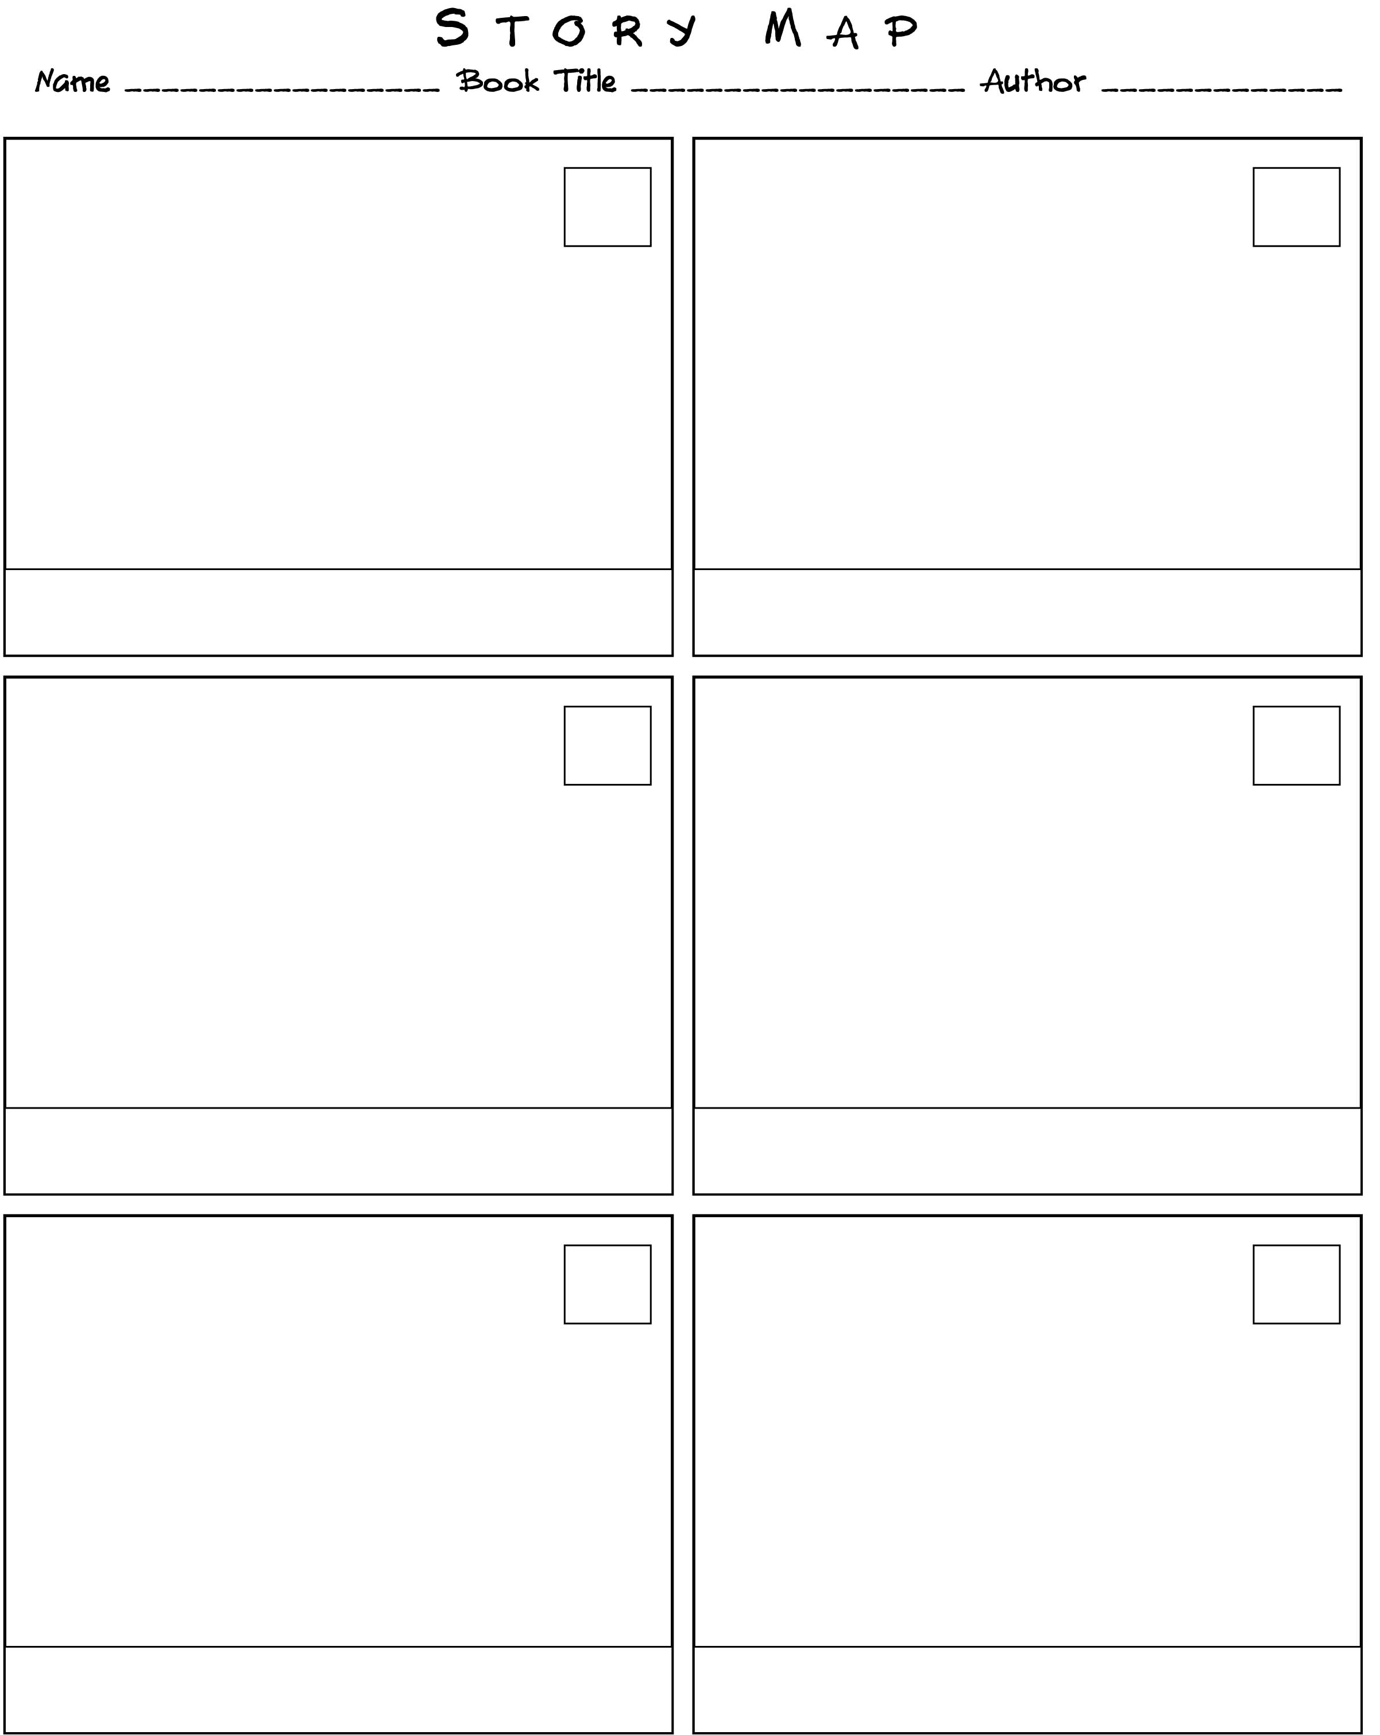
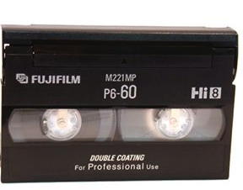
Keep tapes and story maps in cabinets –Do not take home

Slide 7
Keep cabinets open until you come back

Slide 8
RETURN TRIPOD CLIP

Slide 9
Do not walk/move with the tripod open.

Slide 10
Never walk around the camera on the tripod – or carry camera as part of tripod

Slide 11
Don’t leave camera unattended

Slide 12
Responsibilities, Procedures and Guidelines for Taping

Slide 13
DO NOT tape in instructional areas

Slide 14
DO NOT get students out of academics- non- academics need a note from the teacher

Slide 15
Must have a badge to leave room

Slide 16
Nobody LEAVES campus to tape

Slide 17
Illegal to tape in bathrooms/ locker rooms

Slide 18
Do not abuse privilege/power

Slide 19
Do not tape on first 30 seconds of new tape. Leave lens cap on and tape.

Slide 20
Use only your color camera, computer

