Slide 6
Medium Shot
Shot frames the subject from the waist up when it is desirable to see the subject’s facial expression in the context of their body language.

Slide 9
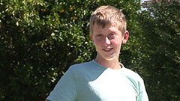
Medium Close Up
The Medium Close up is half way between a mid shot and close up. This shot shows the face more clearly, without getting uncomfortably close.
T.

Slide 10
Extreme Close Up
This shot generally magnifies an object beyond what the human eye can perceive in reality. It is an artificial shot used from dramatic effect.

Slide 11
Cutaway : shot is the interruption of a continuously filmed action by inserting a view of something else. It is usually followed by a cut back to the first shot

Slide 13
Over the Shoulder
This shot is framed from behind a person who is looking at the subject featured in the frame. This shot helps to establish the position of each person and get the feeling of looking a the individual from the other’s point of view. Great for interviews.

Slide 16
Low Angle
This angle gives the subject an increased height and sense of speeded motion. It makes the subject seem ]powerful and may cause a sense of insecurity within the viewer.

Slide 22
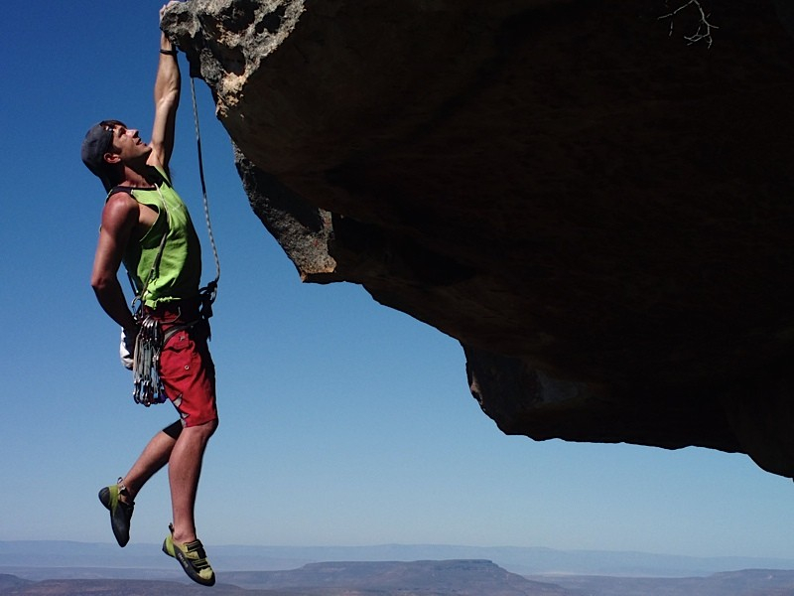

Slide 23
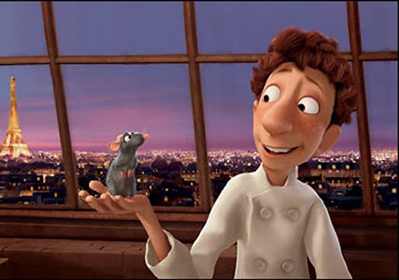

Slide 24
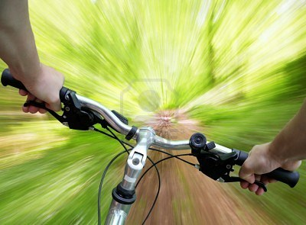

Slide 25
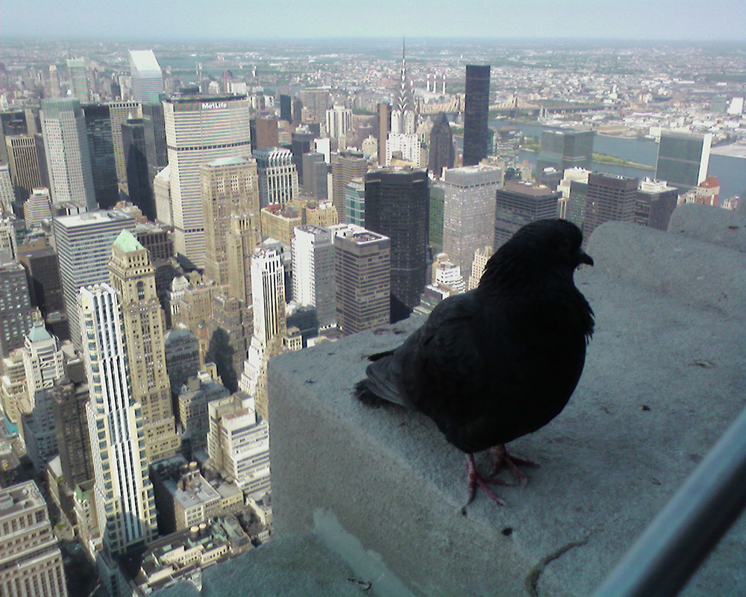

Slide 26
